Slide 1

B.Tech Final Project Presentation on OceanClear : AI-Based Underwater Image Enhancement System
Department of Computer Science and Engineering
Registration no. | Student Name
SIMRAN SHRAMA | 22ETIS411036
PRATHYUSHA S | 22ETIS411026
NAVYA CP | 22ETIS411303
THARUN KUMAR LM | 22ETIS411041
Mentor : DR YOGESH KM
Asst. Professor
Dept. of CSE, MSRUAS, Bengaluru
Group No. :PB34

Slide 2
Outline
Problem Statement & Motivation
Objectives
Existing System
Proposed System
System Architecture
Implementation and Testing
Result Analysis and Discussions
Live Demonstration
Conclusion
Future Scope
References

Slide 3
Problem Statement and Motivation
Underwater images suffer from multiple distortions:
Color distortion (loss of red, dominance of blue/green)
Low contrast due to light attenuation
Haze and blur caused by scattering
Noise from suspended particles
Main Causes:
Light absorption (red absorbed quickly)
Light scattering (reduces clarity)

Slide 4
Problem Statement and Motivation
Motivation:
Critical for applications such as:
Marine ecosystem monitoring
Underwater robotics and navigation
Scientific imaging and surveillance
Traditional enhancement techniques lack adaptability to complex underwater conditions

Slide 5
Objectives
To identify the major challenges in underwater images such as color distortion, low contrast, and reduced visibility caused by light absorption and scattering in water.
To analyze existing image enhancement techniques and machine learning approaches used for improving underwater image quality.
To develop a machine learning-based model that enhances underwater images by improving color balance, contrast, and visibility.
To evaluate the performance of the proposed model using image quality metrics such as PSNR and SSIM by comparing original and enhanced images.

Slide 6
Existing System
Ref | Title & Year | Methodology | Dataset | Limitations | Observations
[1] | Deep Underwater Image Enhancement (UWCNN), 2018 | CNN-based model trained on synthetic underwater images | Synthetic underwater dataset | Limited real-world dataset usage | CNN effectively improves color correction and visibility in underwater images.
[2] | UWGAN: Underwater GAN for Real-World Enhancement, 2019 | Generative Adversarial Network (GAN) with U-Net architecture | Synthetic underwater dataset | Requires high computational power | GAN generates realistic underwater images and restores color distortions effectively.
[3] | Deep SESR for Underwater Enhancement and Super-Resolution, 2020 | Residual network with GAN for simultaneous enhancement and super-resolutioN | UFO-120 dataset | Complex training process | Improves image sharpness, color correction, and resolution simultaneously.
[4] | UIEC²-Net: CNN-based Underwater Image Enhancement, 2021 | CNN using dual color spaces for enhancement | UIEB dataset | Limited generalization in extreme conditions | Achieves good color restoration and contrast improvement in underwater images.
[5] | SGUIE-Net: Semantic Attention Guided Enhancement, 2022 | Attention-based CNN with semantic region guidance | Multiple underwater datasets | Requires labeled semantic information | Improves detail restoration and region-based enhancement.

Slide 7
Ref | Title & Year | Methodology | Dataset | Limitations | Observations
[6] | FE-GAN: Fast and Efficient Underwater Image Enhancement, 2022 | Conditional GAN architecture | UIEB dataset | Training instability in GAN models | Provides efficient enhancement with improved generalization performance.
[7] | Zero-Shot Underwater Image Enhancement Network, 2023 | Zero-shot deep learning model with level adjustment | Real underwater images | Performance depends on scene conditions | Removes haze and corrects color distortion without paired training data.
[8] | MuLA-GAN: Multi-Level Attention GAN, 2023 | GAN with multi-level attention mechanism | UIEB dataset | High model complexity | Achieves better PSNR and SSIM compared to earlier enhancement models.
[9] | Autoencoder-based Deep Learning Enhancement, 2024 | Deep autoencoder architecture | Multiple underwater datasets | Limited feature representation for complex scenes | Reduces blue/green color distortion and improves visual quality.
[10] | Ensemble Deep Learning for Underwater Image Enhancement, 2024 | Combination of spatial and deep learning approaches | UIEB and EUVP datasets | Higher computational cost | Improves brightness, structure preservation, and contrast.

Slide 8
Existing System
SUMMARY OF EXISTING SYSTEM
Existing methods focus mainly on color correction or contrast enhancement, but fail to address all underwater distortions.
Many models require large datasets and high computational power.
Some methods are trained only on synthetic datasets, reducing real-world performance.
There is a need for an efficient machine learning model that improves image quality while maintaining structural details in real underwater environments.

Slide 9
Proposed System
OceanClear is a deep learning-based framework for underwater image enhancement that learns mappings between degraded and high-quality images.
Workflow:
Input: Distorted underwater image
Preprocessing:
Resizing (256×256)
Normalization
Noise removal
Model Training using UIEB dataset
Output: Enhanced image

Slide 10
Proposed System
Key Features:
Handles multiple distortions simultaneously
Improves:
Color correction
Contrast
Visibility
Works on real-world datasets
Advantages:
Better accuracy
Automatic feature learning
Scalable for future applications

Slide 11
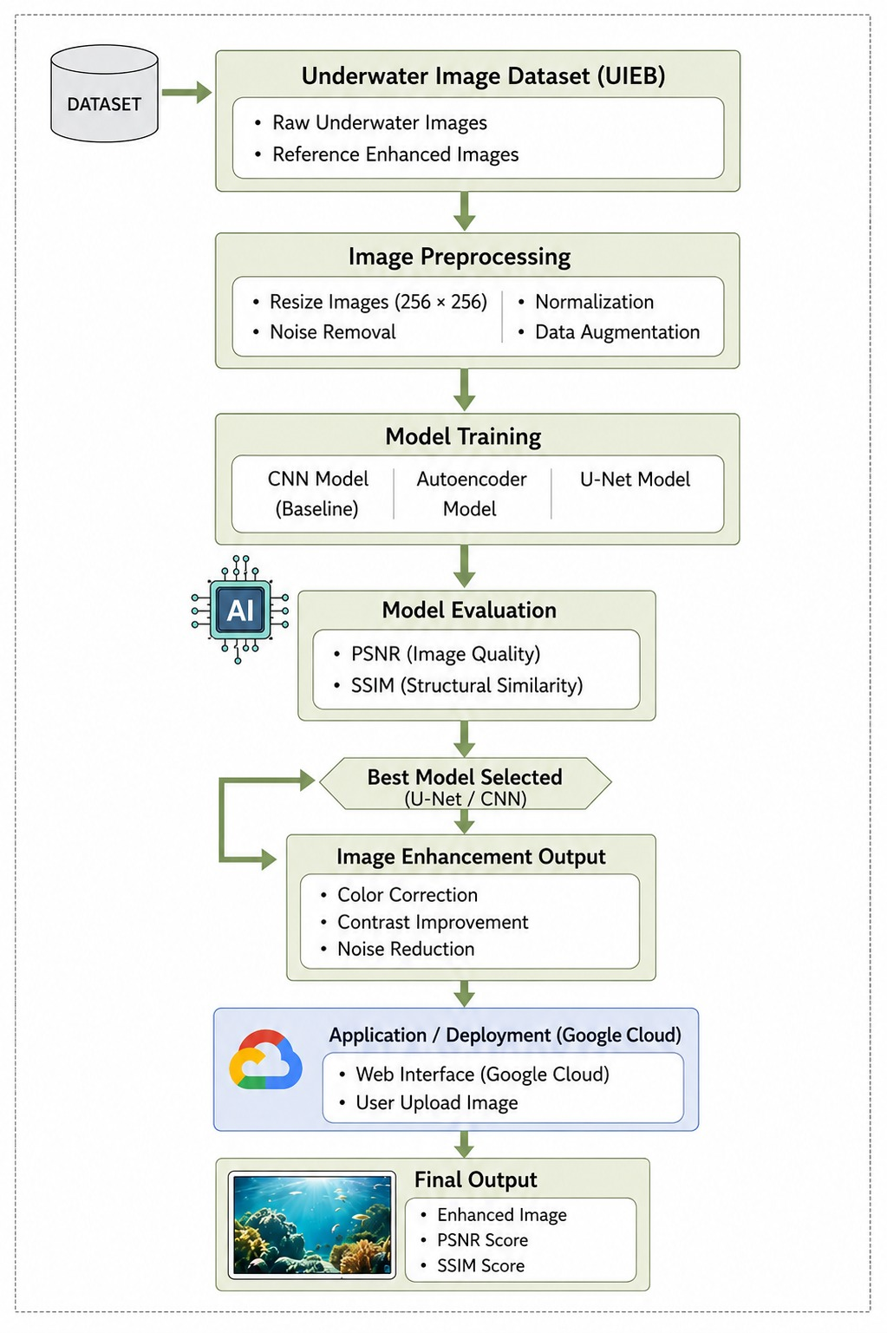
System Architecture/Block Diagram

Slide 12
System Architecture
Dataset Collection
Underwater image datasets such as UIEB(Underwater Image Enhancement Benchmark)are collected to train and test the enhancement model under different underwater conditions.
Image Preprocessing
Resize Images : Images are resized to a fixed dimension (e.g., 256×256) to ensure uniform input for the model.
Noise Removal : Filtering techniques are applied to remove noise caused by underwater particles and lighting conditions.
Normalization : Pixel values are scaled between 0 and 1 to improve training efficiency and model performance.

Slide 13
System Architecture
Model layer
CNN, Autoencoder and U-Net deep learning model is used to learn image features and enhance underwater images by improving contrast and color balance.
Evaluation
The enhanced images are compared with original images using PSNR and SSIM metrics to measure improvement in image quality. Based on this score best model is selected
Output Layer
Generate enhanced image using the best model

Slide 14
Implementation and Testing Approach
Programming Language: Python
Frameworks: PyTorch
Tools: VS Code
Deployment: Streamlit Web Application
Dataset Details:
Dataset: UIEB (Underwater Image Enhancement Benchmark)
Total images: 950
890 paired (input + reference)
60 challenging images
Image size: Resized to 256 × 256

Slide 15
Implementation and Testing Approach
Model Selection
CNN → Moderate enhancement
Autoencoder → Better noise reduction
U-Net → Superior detail preservation
Performance Evaluation
MODEL | PSNR | SSIM
CNN | 18.54 | 0.807
AUTOENCODER | 17.49 | 0.591
U-NET | 19.72 | 0.844

Slide 16
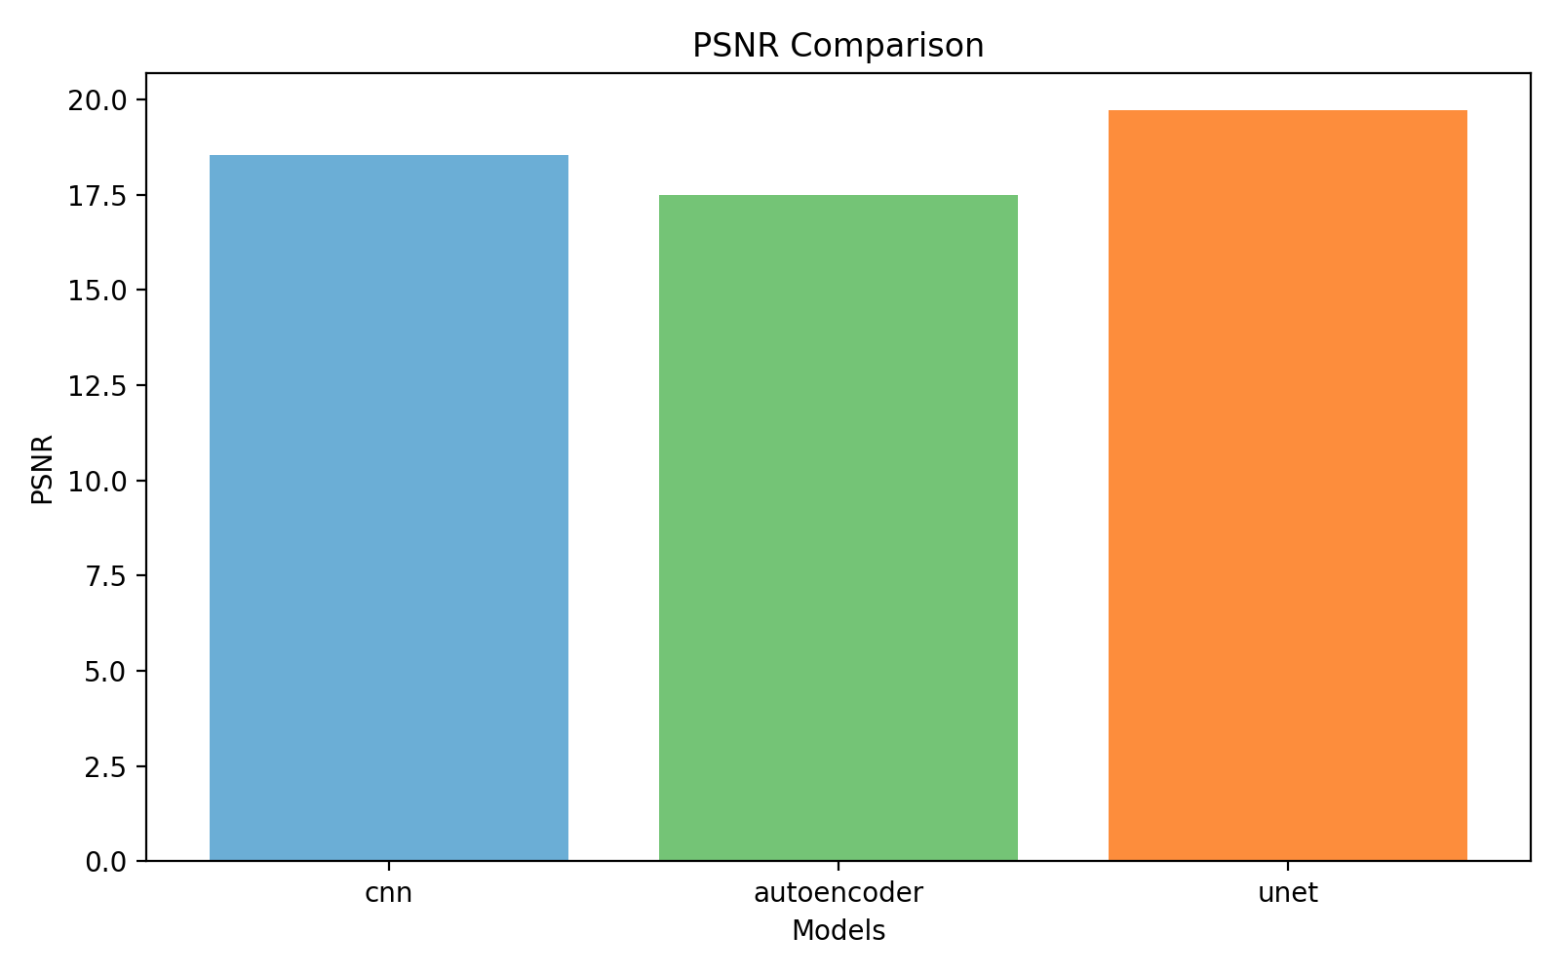
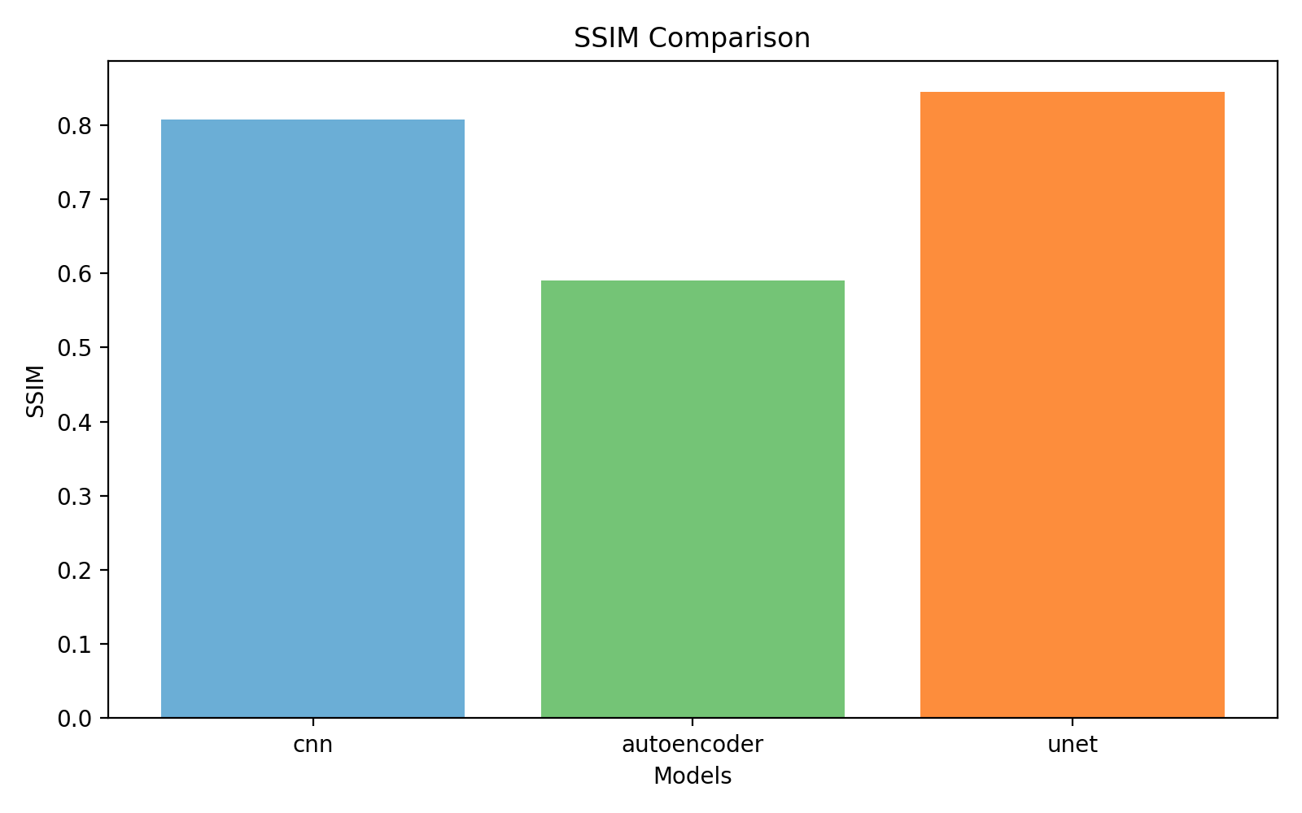
Implementation and Testing Approach
Graphical Analysis
U-Net consistently outperforms CNN and Autoencoder
Higher PSNR → Better image reconstruction
Higher SSIM → Better perceptual quality

Slide 17
Result Analysis and Discussions
U-Net achieved the highest PSNR (19.72) and SSIM (0.844), showing superior enhancement performance.
CNN provided moderate enhancement with acceptable image reconstruction quality.
Autoencoder reduced underwater noise effectively but preserved fewer texture details.
Enhanced outputs showed better visibility, improved colour balance, and higher contrast compared to original underwater images.
Experimental results prove that deep learning models perform better than traditional underwater enhancement techniques.

Slide 18
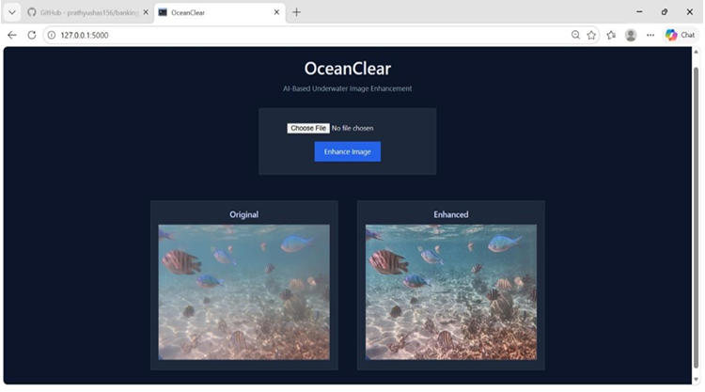
Result Analysis and Discussions

Slide 19
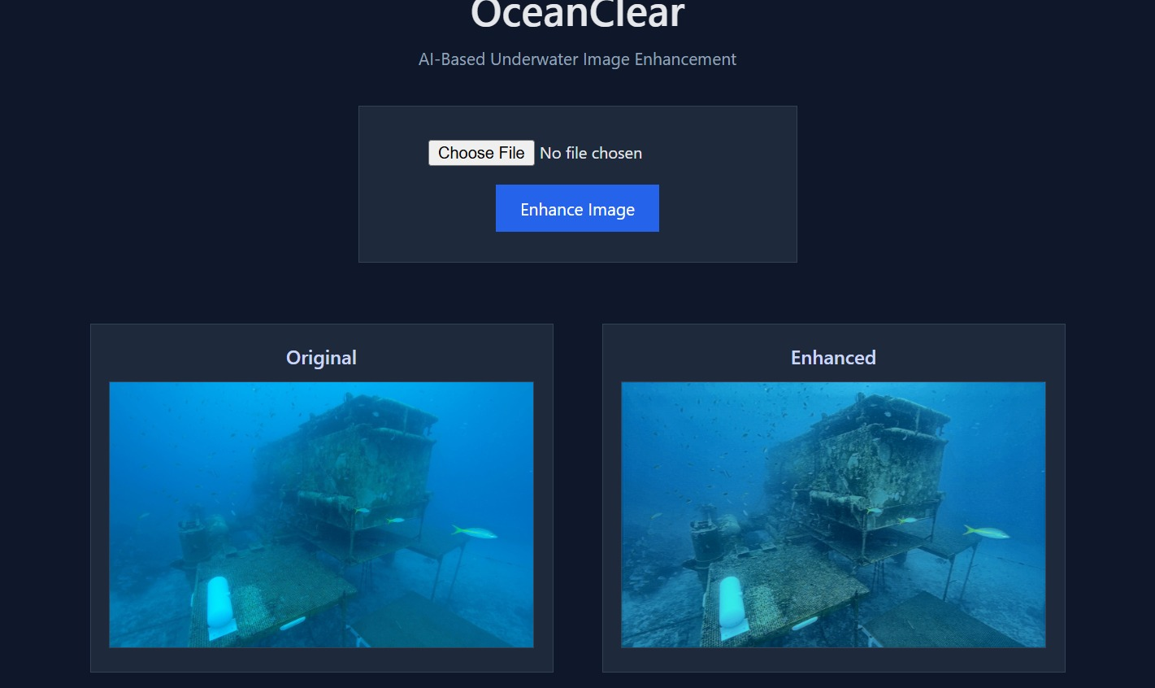
Result Analysis and Discussions

Slide 20
Sustainable Development Goals(SDG)
SDG No. | SDG Goal | Description / Justification
SDG 14 | Life Below Water | The project helps improve underwater image quality, which supports monitoring of marine ecosystems, coral reefs, and underwater biodiversity.
SDG 9 | Industry, Innovation and Infrastructure | The use of machine learning for underwater image enhancement promotes technological innovation and supports advanced research in marine technology and imaging systems.
SDG 13 | Climate Action | Enhanced underwater images can help researchers monitor ocean conditions and environmental changes, contributing to better climate and marine ecosystem studies.

Slide 21
Live Demonstration
https://oceanclear-18332670789.us-central1.run.app/

Slide 22
Conclusion
Created a deep learning-based underwater image enhancement framework based on the UIEB dataset, which enhances color balance, contrast, and noise removal with the help of effective preprocessing methods.
Applied and contrasted CNN, Autoencoder, and U-Net models.
Compared performance based on PSNR and SSIM, and quantitative and visual outcomes indicated a significant improvement, even with difficult underwater images in the real world.

Slide 23
Future Scope
Potential future enhancement focus would be on the investigation of deeper learning methods used to develop a smaller architecture to run on small-scale portable devices as well as on systems used to operate in a lower power underwater environment. Lightweight models would enable deployment in underwater drones and portable marine monitoring systems.
Advanced artificial intelligence techniques such as:
Generative Adversarial Networks (GANs)
Vision Transformers
Diffusion Models
Reinforcement Learning
can be explored to further improve underwater image restoration and visual quality.

Slide 24
References
1. Anwar, S., Li, C., & Porikli, F., “Deep Underwater Image Enhancement,” arXiv preprint arXiv:1807.03528, 2018.
2. Fabbri, C., Islam, M. J., & Sattar, J., “Enhancing Underwater Imagery using Generative Adversarial Networks,” IEEE International Conference on Robotics and Automation (ICRA), 2019.
3. Islam, M. J., Xia, Y., & Sattar, J., “Fast Underwater Image Enhancement for Improved Visual Perception,” IEEE Robotics and Automation Letters, 2020.
4. Li, C., Guo, J., Guo, C., & Cong, R., “Underwater Image Enhancement Benchmark (UIEB) and Water-Net,” IEEE Transactions on Image Processing, 2021.
5. Guo, C., Li, C., Guo, J., Cong, R., Fu, H., & Hou, J., “Emerging from Water: Underwater Image Color Correction Based on Weakly Supervised Learning,” IEEE Signal Processing Letters, 2022.

Slide 25
References
6. Peng, Y., Cao, K., & Zhang, J., “SGUIE-Net: Semantic Attention Guided Underwater Image Enhancement,” IEEE Transactions on Multimedia, 2022.
7. Li, Z., Yang, Y., & Chen, H., “Zero-Shot Underwater Image Enhancement Using Deep Learning,” IEEE Access, 2023.
8. Zhao, X., Zhang, Y., & Wang, H., “MuLA-GAN: Multi-Level Attention GAN for Underwater Image Enhancement,” IEEE Transactions on Circuits and Systems for Video Technology, 2023.
9. Kumar, A., Singh, P., & Sharma, R., “Deep Autoencoder Based Underwater Image Enhancement,” Journal of Visual Communication and Image Representation, 2024.
10. Zhang, L., Chen, Y., & Li, H., “Hybrid Deep Learning Framework for Underwater Image Enhancement,” Pattern Recognition Letters, 2025.

Slide 26
Thank You

